Slide 1
Thesis Defense: Analysis of Various Algorithmic Approaches to Software-Based APRS Packet Demodulation
By: Robert Campbell
Committee Members: Dr. John Bellardo, Dr. Bridget Benson, and Dr. Dennis Derickson
Notes:
Introduce People in the room

Slide 2
What is APRS?
Automated Packet Reporting System.
A digital communication method used by hams.
Encoded into the Radio Using Bell 202
Notes:
Discuss Digital vs Analog Communication. Ironic note about how APRS is both.
Packet content can be many things but most commonly is a GPS position.
Mention that Bell 202 is the key to this research (not too much detail about what it is since that will be covered later)

Slide 3
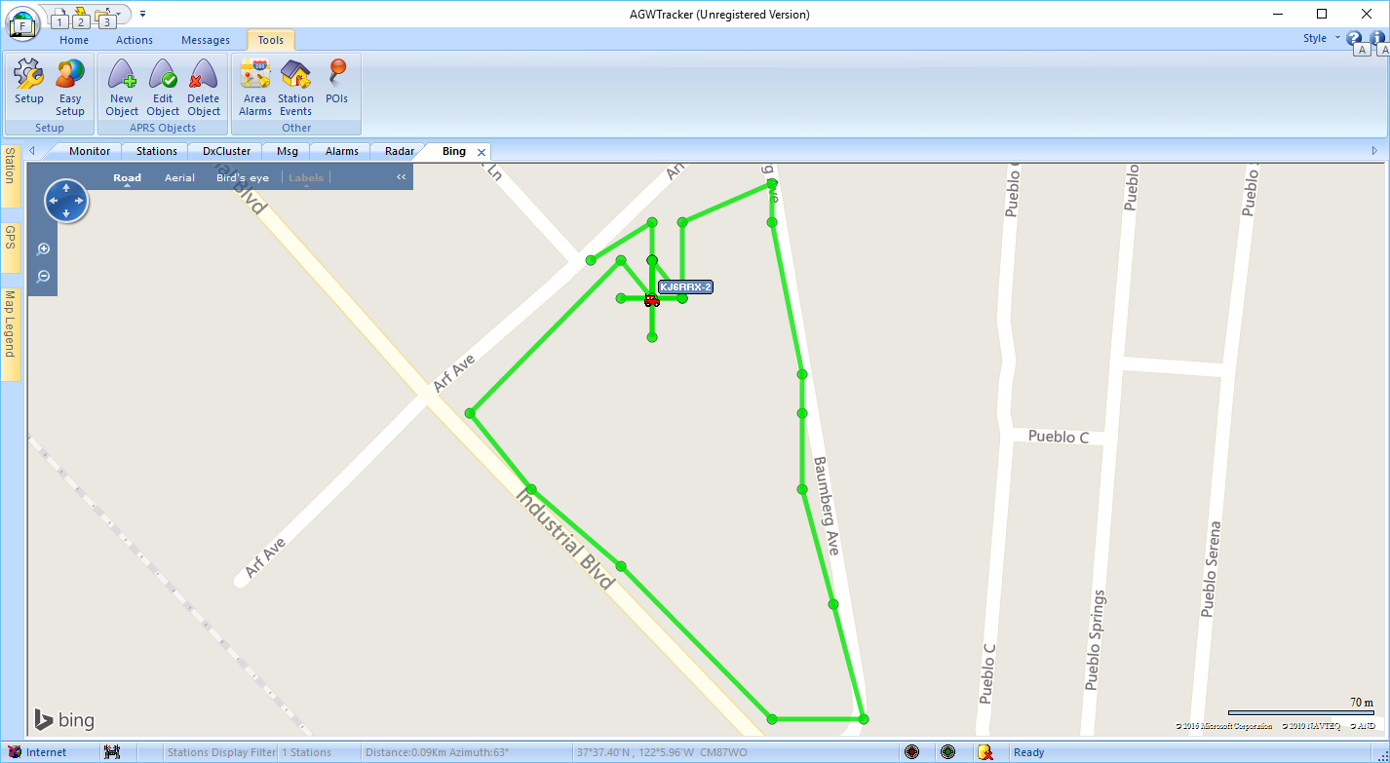
What does APRS look like?
Notes:
AGWTracker, AGWPE, Wildflower, course maps.

Slide 4
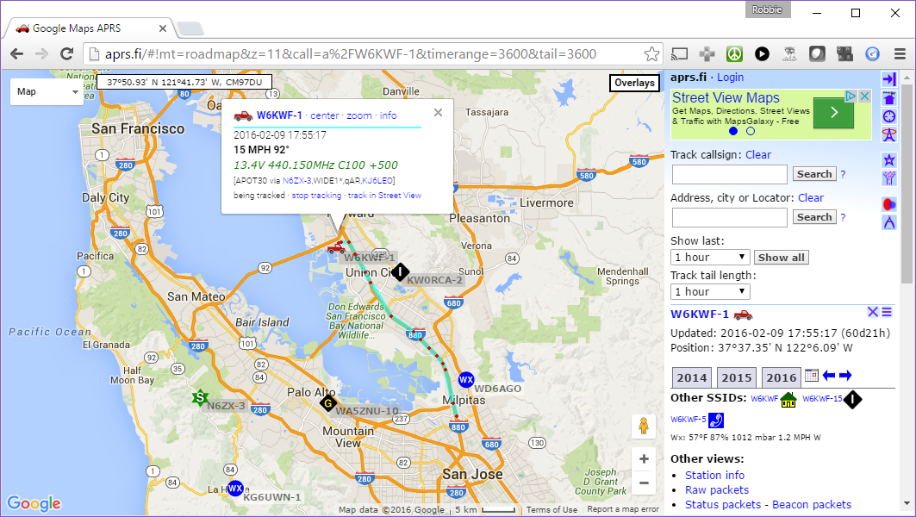
What does APRS look like?
Notes:
Walk through of APRS.fi show:
-Stations
-Tracks
-Messages
-Telemetry

Slide 5
Approaches to Accessing the Network
Terminal Node Controllers
Specialty APRS Hardware
Radio Integrated
Software

Slide 6
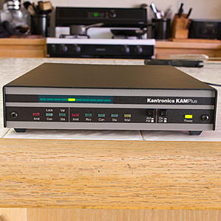
TNC Examples
Notes:
Pass around examples, show that there is a radio port and COM port that can be found on each.

Slide 7
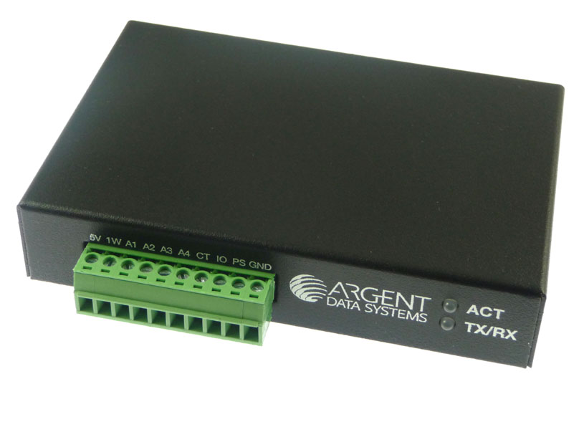
Argent Data Open Trackers

Slide 8
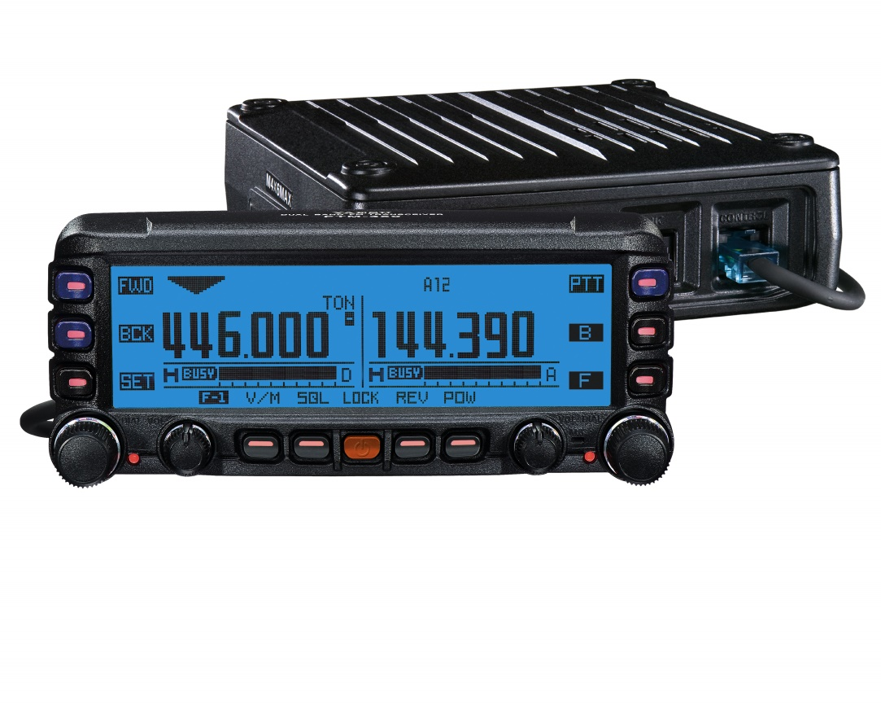
Radio Integrated APRS

Slide 9
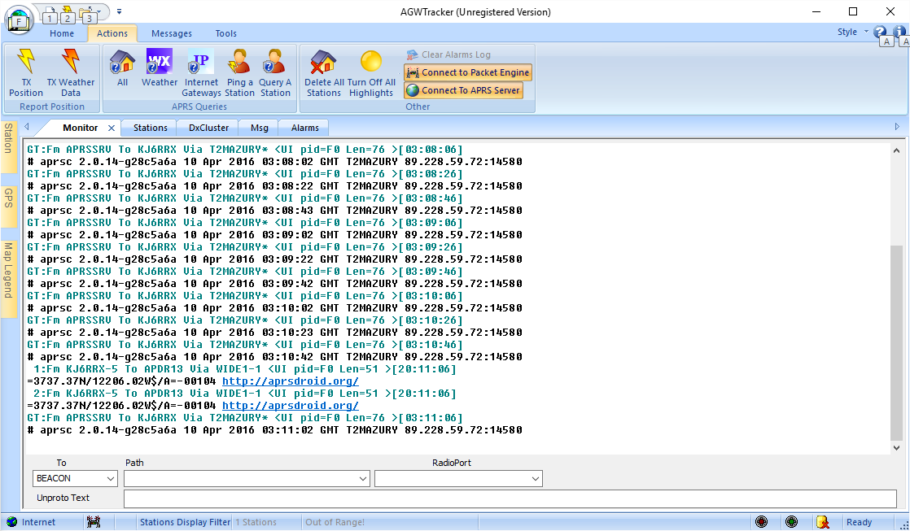
AGWPE

Slide 10
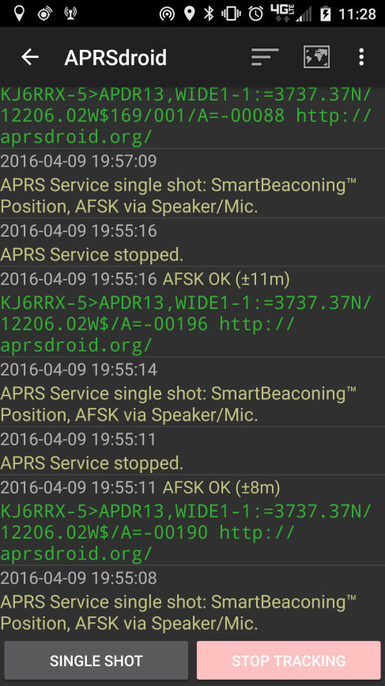
javAX25 in APRSdroid

Slide 11
The Sine Wave
y(t) = A sin(2πft + φ)
f = 1 (f = 1/T)
A = 1
φ = -π/4
A
φ
T
Notes:
Frequency is in Hertz
Frequency and Period are Inverse. Longer (larger) period is a lower (smaller) frequency, Shorter period is a higher (larger) frequency.
Phi is the phase

Slide 12
Bell 202
1200 Baud AFSK using 1200Hz and 2200Hz tones.
Audio Frequency Shift Keying – using multiple tones in the audible range to encode data.
Notes:
Introduce Frequency Shift Keying
A patent for the modem chip to modulate and demodulate the digital data was filed in 1981
V.23 with 1300Hz and 2100Hz tones in 1988

Slide 13
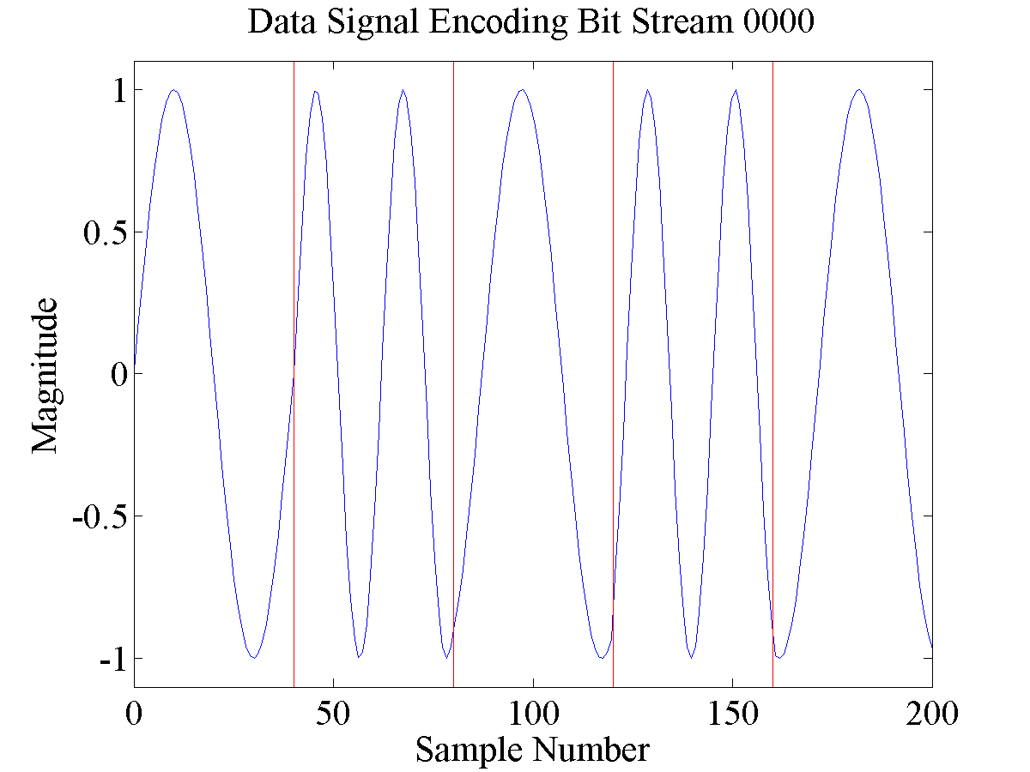
Example Signal
Notes:
1200Hz and 2200Hz tones.
Since 2200Hz doesn’t divide evenly in a 1200 baud bit period you can see that it changes the phase.

Slide 14

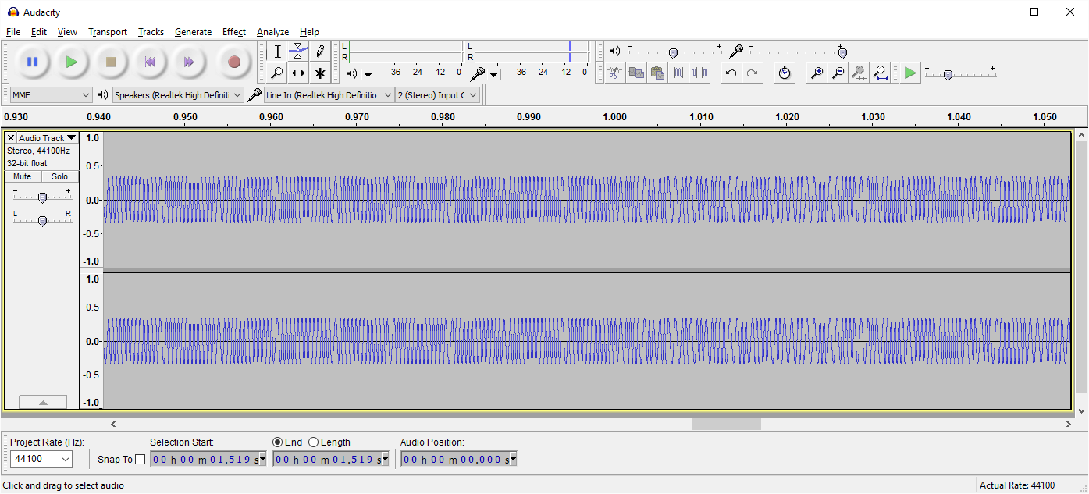
It’s in the audible range
What’s it sound like?
Notes:
Play Example APRS packet
Brief introduction to flags. Data is only contained in 0.5s worth of the audio file.

Slide 15
How to demodulate this signal?
Edge Detection
Correlation
Filters
Phase Locked Loop
Notes:
These approaches are shared in both hardware and software based approaches.

Slide 16
Edge Detection
Look for rising and falling edges
Distance between consecutive “zero-crossings” is T/2
T/2
T/2
Notes:
Mention that this method is especially susceptible to the challenges to be presented later.

Slide 17
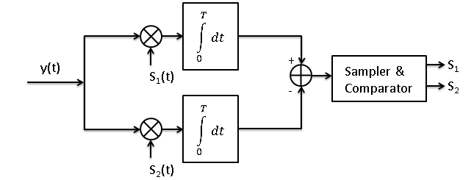
Correlation
Correlates original signal with expected signals.
Notes:
S1 and s2 are the 1200Hz and 2200Hz signals

Slide 18
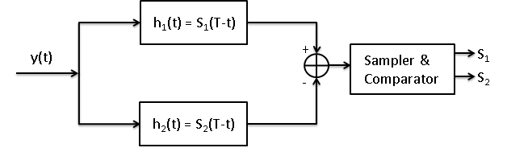
Filters
Filters look at signal strength of individual frequencies.
Notes:
h1(t) and h2(t) are the outputs from applying the respective filters at 1200Hz and 2200Hz

Slide 19
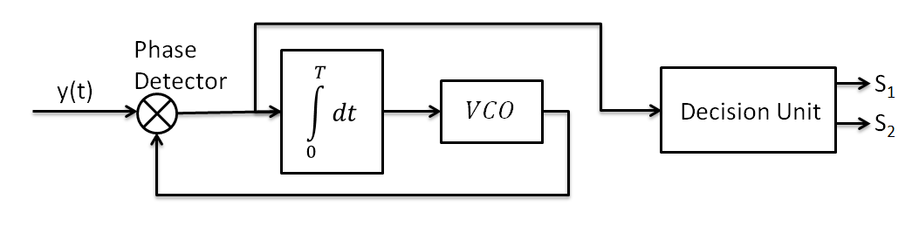
Phase Locked Loop (PLL)
Phase lock is acquired on the original signal.
As long as the VCO is locked the signal is known.
Notes:
Incoming signal is mixed with the output from the VCO (Voltage Controlled Oscillator)
Phase is filtered then passed back to the VCO
Phase / Frequency information is used to decide which frequency is present.

Slide 20
Challenges
DC Offset
Noise
Emphasis
Notes:
These are just some examples of challenges that were encountered during this research.
Other challenges include:
-RF Limitations including limited coverage
-Multiple stations transmitting at the same time

Slide 21
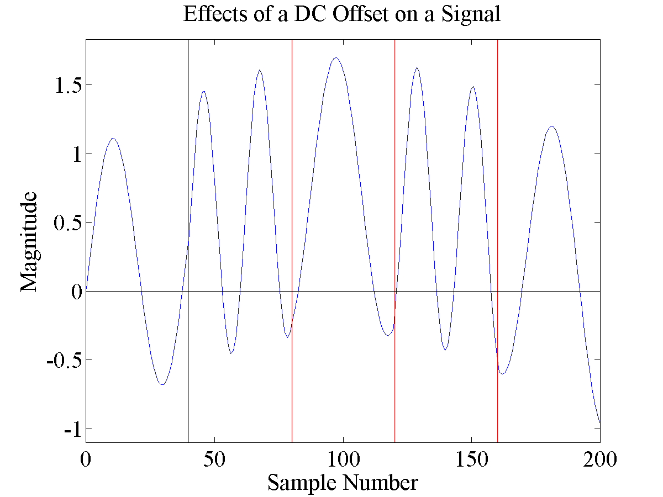
DC Offset
Notes:
Notice that the average is above zero
Notice the zero crossings are not even

Slide 22
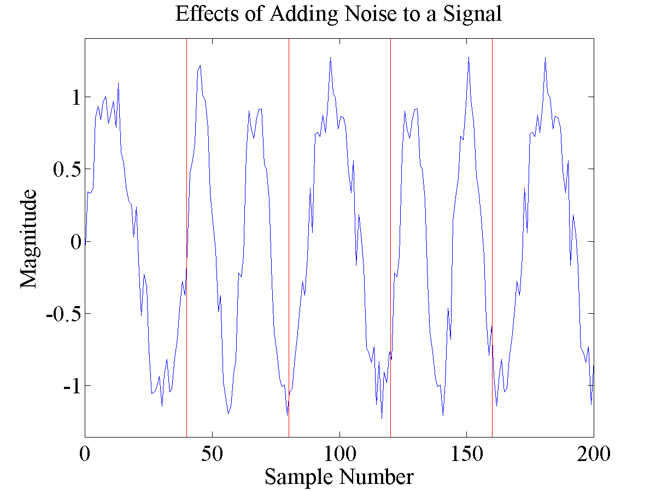
Noise
Notes:
The jitter may cause one signal to look like another extending or shortening zero crossings.

Slide 23
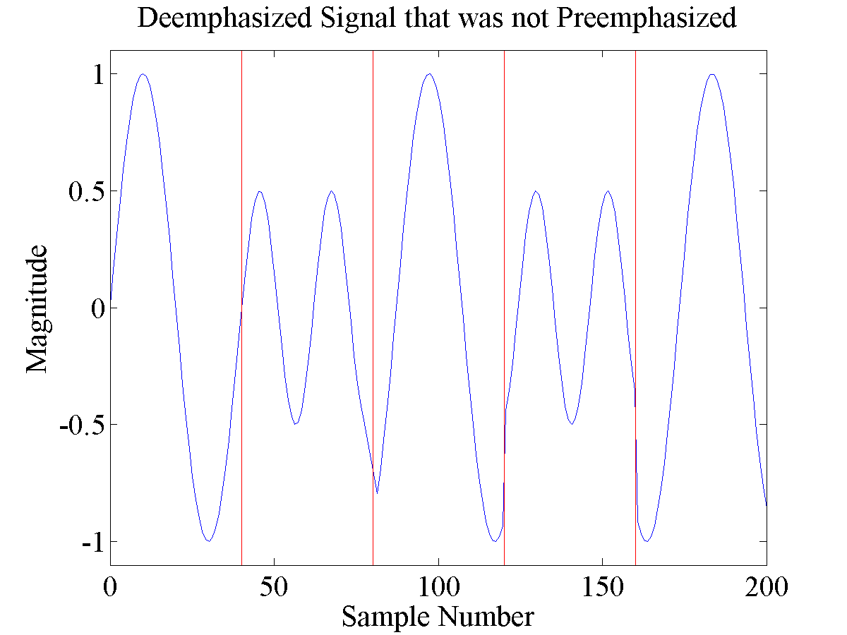
Emphasis
Notes:
This is a challenge for any filter because it can not be assumed that the relative magnitudes of the signals are the same.

Slide 24
Algorithms Implemented
Zero Crossing
Goertzel (DFT / Filtering)
PLL
Preclocking

Slide 25
Zero Crossing
Zero Crossing
Strict Zero Crossing
Windowed Zero Crossing
Peak

Slide 26
Strict Zero Crossing
if ((isSignalHigh && isBelowZero(sample))
|| (!isSignalHigh && isAboveZero(sample))) {
handleZeroCrossing();
samplesSinceLastXing = 0;
isSignalHigh = !isSignalHigh;
}

Slide 27
Zero Crossing
//going low to high
if (!isSignalHigh && samples.get(samples.size() - 1) > averageValueInHistory + zeroCrossingThreshold) {
// Its going high!
isSignalHigh = true;
handleZeroCrossing();
}
//going high to low
if (isSignalHigh && samples.get(samples.size() - 1) < averageValueInHistory - zeroCrossingThreshold) {
// Its going low!!
isSignalHigh = false;
handleZeroCrossing();
}
Notes:
Notice the adujustable “zero”

Slide 28
Goertzel (DFT / Filtering)
double power = (s1200_prev2*s1200_prev2+s1200_prev*s1200_prev-coeff1200*s1200_prev*s1200_prev2) -
(s2200_prev2*s2200_prev2+s2200_prev*s2200_prev-coeff2200*s2200_prev*s2200_prev2);
Notes:
Only multiplication and addition no other complicated computations i.e. integrals or sines

Slide 29
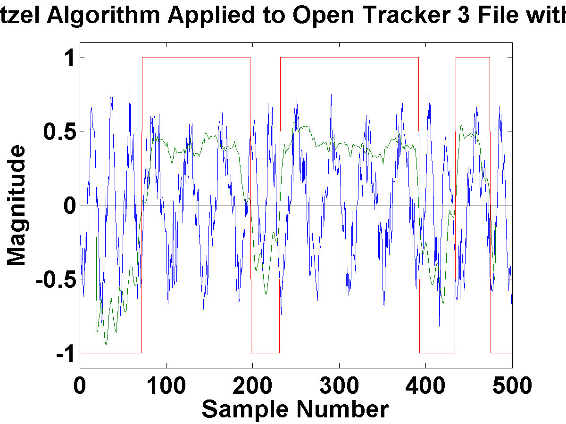
Goertzel Trial Run in MATLAB
Notes:
This is on the OT3 Test with noise.

Slide 30
PLL
// Mix VCO with incoming signal
double pll_loop_control = sample * ref_sig * pll_loop_gain;
// Filter
double output = biQuad.filter(pll_loop_control);
pll_integral += pll_loop_control / sample_rate;
// Update VCO
ref_sig = (float) Math.sin(2 * Math.PI * pll_cf * (t + pll_integral));
int bits = Math.round(samplesSinceLastTransition / samplesPerBit);
if ((bits > 0) && ((output > 0 && !lastGreaterThanZero) || (output < 0 && lastGreaterThanZero))) {
handleDemodulatedBits(bits);
samplesSinceLastTransition = 0;
}

Slide 31
Preclocking

Slide 32
Benchmarking
OT3 Test
javAX25 Generated 200
OT3 Test + Ramping Noise
Track 1
Track 2

Slide 33
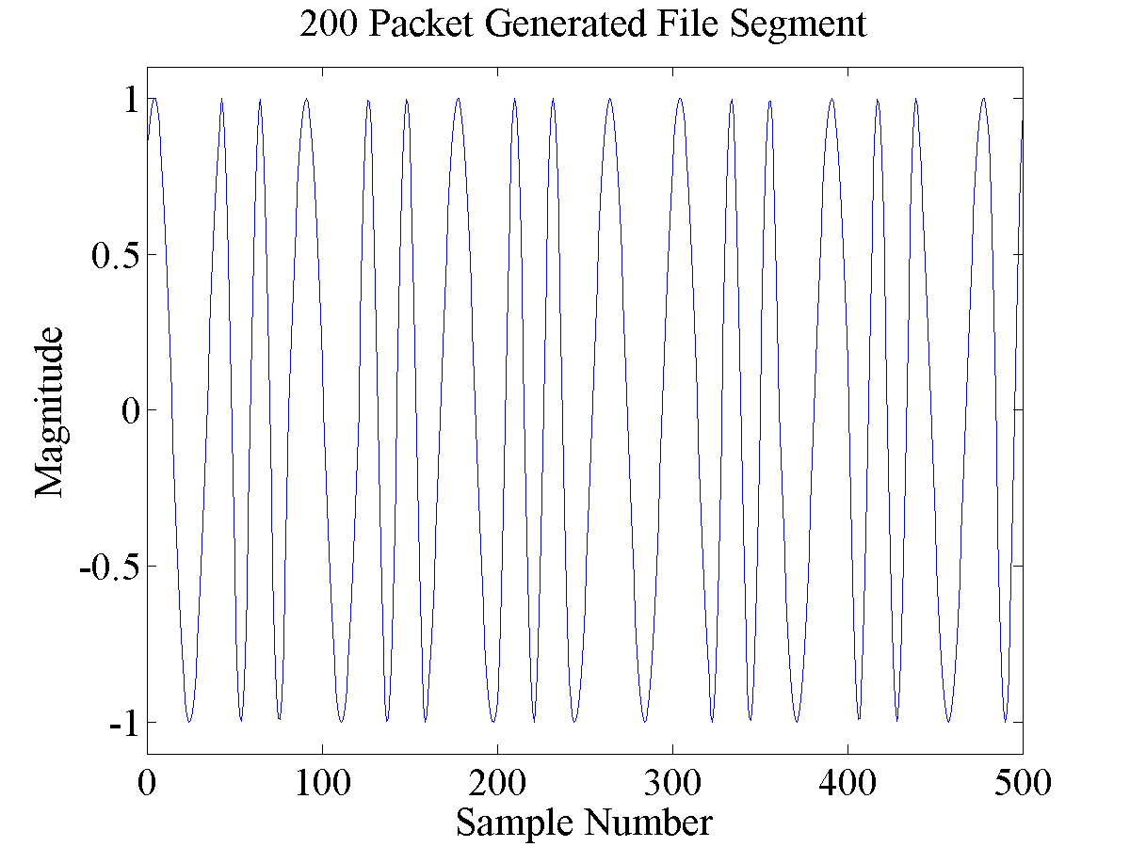
Clean Signal Example

Slide 34
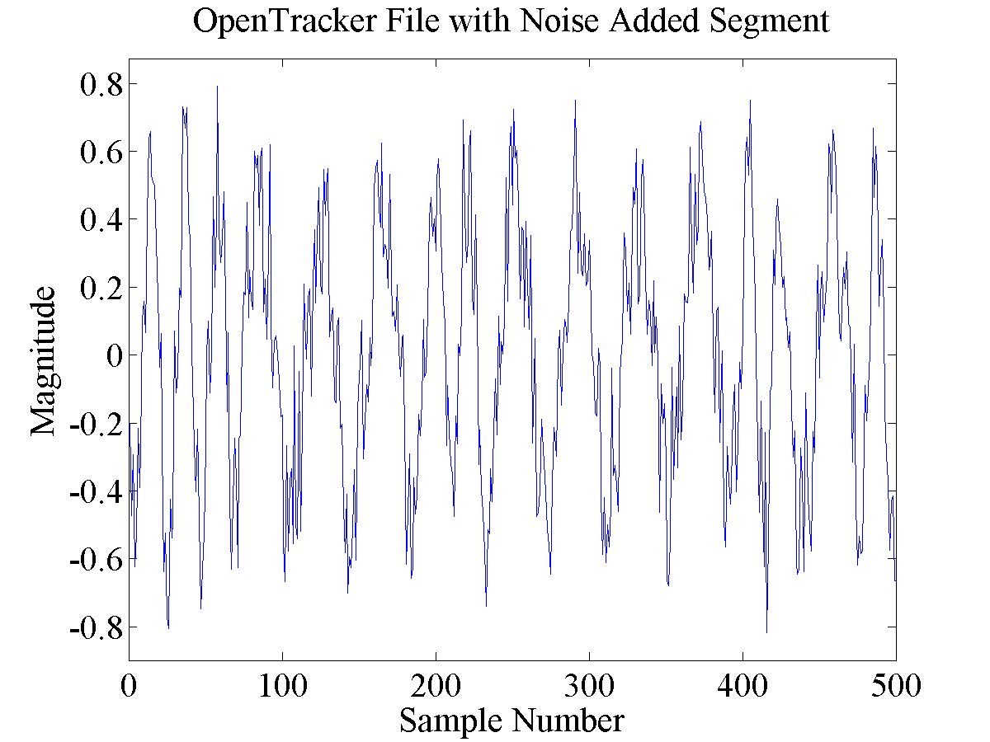
Noise Example

Slide 35
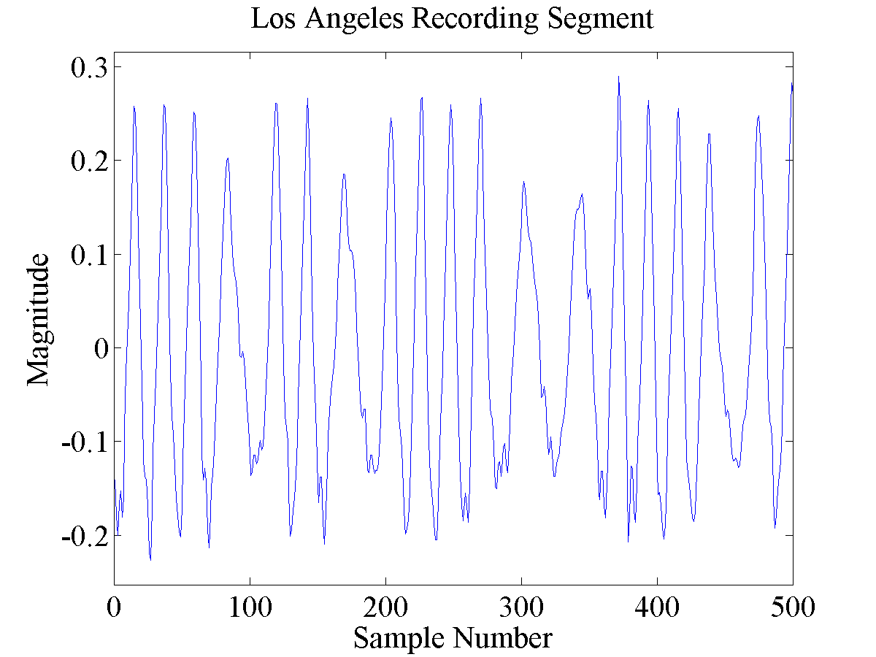
Track 1 Example

Slide 36
The Big Table-O-Data
.wav file | Filtering | Correlation | Zero Crossing | Strict Zero Crossing | Windowed Zero | Peak | Derivative | Goertzel (100%) | Goertzel Optimized window | PLL | PreClocking | Goertzel PreClocking | Goertzel Max Preclocking | AGWPE | AVERAGE HARDWARE
OT3Test | None | 40 | 35 | 40 | 39 | 3 | 40 | 40 | 40 | 40 | 0 | 40 | 40 | 40 | 39.9166667
 | Bandpass | 40 | 19 | 0 | 0 | 0 | 33 | 40 | 40 | 40 | 40 | 28 | 40
 | Bandpass w/ 6db | 40 | 12 | 40 | 0 | 0 | 14 | 40 | 40 | 0 | 39 | 15 | 40
SoftwareGenerated200 | None | 200 | 200 | 200 | 200 | 200 | 200 | 200 | 200 | 200 | 0 | 200 | 200 | 200 | 199.272727
 | Bandpass | 200 | 27 | 200 | 0 | 0 | 200 | 200 | 200 | 200 | 200 | 106 | 200
 | Bandpass w/ 6db | 200 | 200 | 200 | 0 | 0 | 200 | 200 | 200 | 200 | 200 | 199 | 200
OT3TestWithNoise | None | 24 | 0 | 6 | 0 | 0 | 3 | 17 | 25 | 21 | 0 | 10 | 27 | 21 | 14.5833333
 | Bandpass | 24 | 6 | 2 | 0 | 0 | 5 | 21 | 23 | 23 | 17 | 11 | 26
 | Bandpass w/ 6db | 11 | 1 | 9 | 0 | 0 | 4 | 8 | 6 | 14 | 6 | 5 | 18
LATrack1 | None | 946 | 460 | 568 | 298 | 0 | 543 | 935 | 965 | 925 | 0 | 564 | 806 | 967 | 935.083333
 | Bandpass | 964 | 536 | 151 | 0 | 0 | 422 | 941 | 965 | 654 | 939 | 431 | 813
 | Bandpass w/ 6db | 914 | 53 | 422 | 0 | 0 | 97 | 613 | 512 | 189 | 482 | 224 | 795
LATrack2 | None | 639 | 0 | 0 | 162 | 0 | 5 | 411 | 608 | 0 | 0 | 390 |  | 497 | 777.916667
 | Bandpass | 872 | 0 | 0 | 0 | 0 | 0 | 401 | 448 | 0 | 939 | 230
 | Bandpass w/ 6db | 958 | 209 | 74 | 0 | 0 | 254 | 946 | 956 | 0 | 947 | 392
.wav file | AVERAGE HARDWARE | OT2 | OT3 | OT USB | OT3 Micro | Kam | My Kam Plus | Kam Plus | MFJ-1278 | My PK-88 | PK-88 | PK-232 | PK-232MBX
OT3Test | 39.9166667 | 40 | 40 | 39 | 40 | 40 | 40 | 40 | 40 | 40 | 40 | 40 | 40
SoftwareGenerated200 | 199.272727 | 200 | 200 | 193 | 199 | 200 | 200 | 200 | 200 | 200 |  | 200 | 200
OT3TestWithNoise | 14.5833333 | 5 | 16 | 13 | 12 | 20 | 12 | 12 | 5 | 25 | 25 | 12 | 18
LATrack1 | 935.083333 | 947 | 937 | 869 | 830 | 988 | 958 | 985 | 837 | 981 | 1007 | 918 | 964
LATrack2 | 777.916667 | 927 | 445 | 633 | 263 | 938 | 967 | 998 | 937 | 866 | 633 | 929 | 799

Slide 37
The Big Table-O-Data (Hardware)
.wav file | Filtering | AVERAGE HARDWARE | OT2 | OT3 | OT USB | OT3 Micro | Kam | My Kam Plus | Kam Plus | MFJ-1278 | My PK-88 | PK-88 | PK-232 | PK-232MBX
OT3Test | None | 39.9166667 | 40 | 40 | 39 | 40 | 40 | 40 | 40 | 40 | 40 | 40 | 40 | 40
 | Bandpass
 | Bandpass w/ 6db
SoftwareGenerated200 | None | 199.272727 | 200 | 200 | 193 | 199 | 200 | 200 | 200 | 200 | 200 |  | 200 | 200
 | Bandpass
 | Bandpass w/ 6db
OT3TestWithNoise | None | 14.5833333 | 5 | 16 | 13 | 12 | 20 | 12 | 12 | 5 | 25 | 25 | 12 | 18
 | Bandpass
 | Bandpass w/ 6db
LATrack1 | None | 935.083333 | 947 | 937 | 869 | 830 | 988 | 958 | 985 | 837 | 981 | 1007 | 918 | 964
 | Bandpass
 | Bandpass w/ 6db
LATrack2 | None | 777.916667 | 927 | 445 | 633 | 263 | 938 | 967 | 998 | 937 | 866 | 633 | 929 | 799
 | Bandpass
 | Bandpass w/ 6db

Slide 38
Hardware Results - Clean
Only Hardware that did not decode all packets was:
OpenTracker USB with 39/40 and 193/200
T3-Micro 199/200
Notes:
All other 10 pieces of hardware decoded 40 and 200 packets out of the respective files.

Slide 39
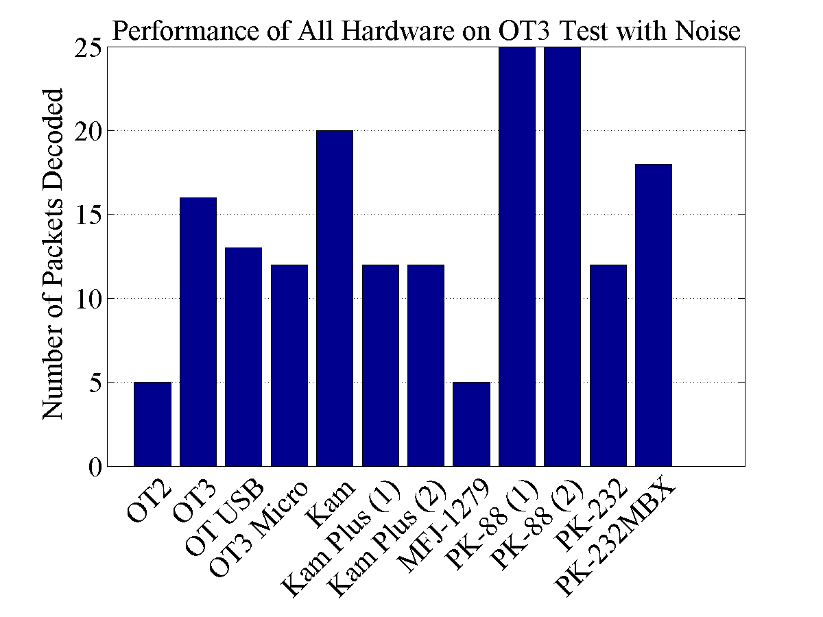
Hardware Results - Noise

Slide 40
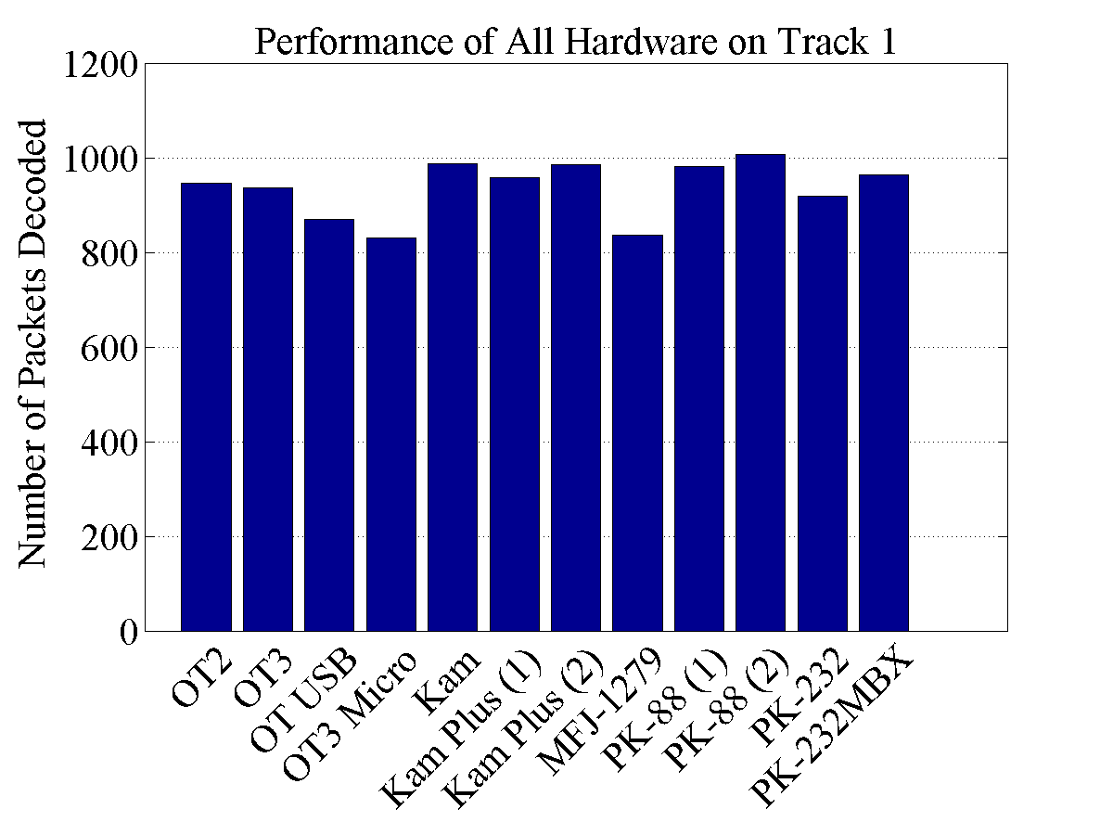
Hardware Results – Track 1

Slide 41
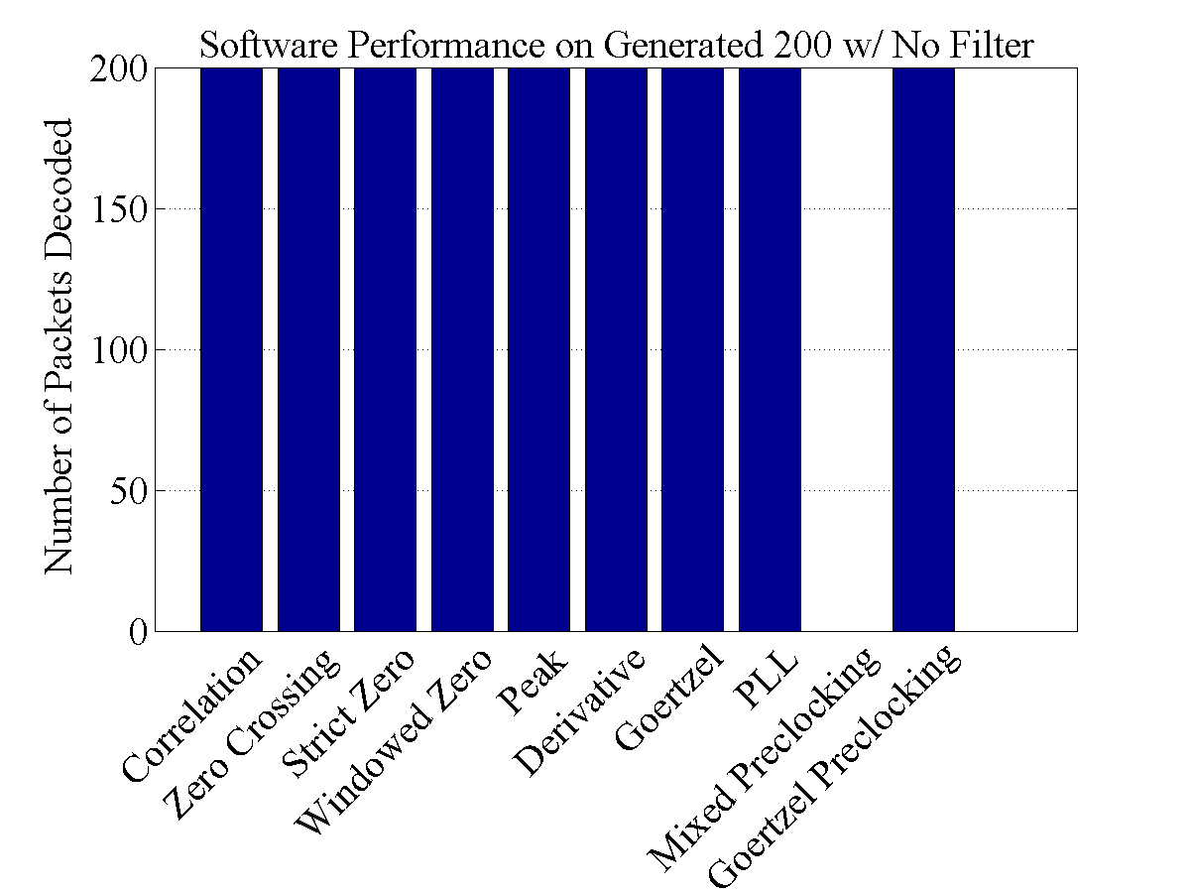
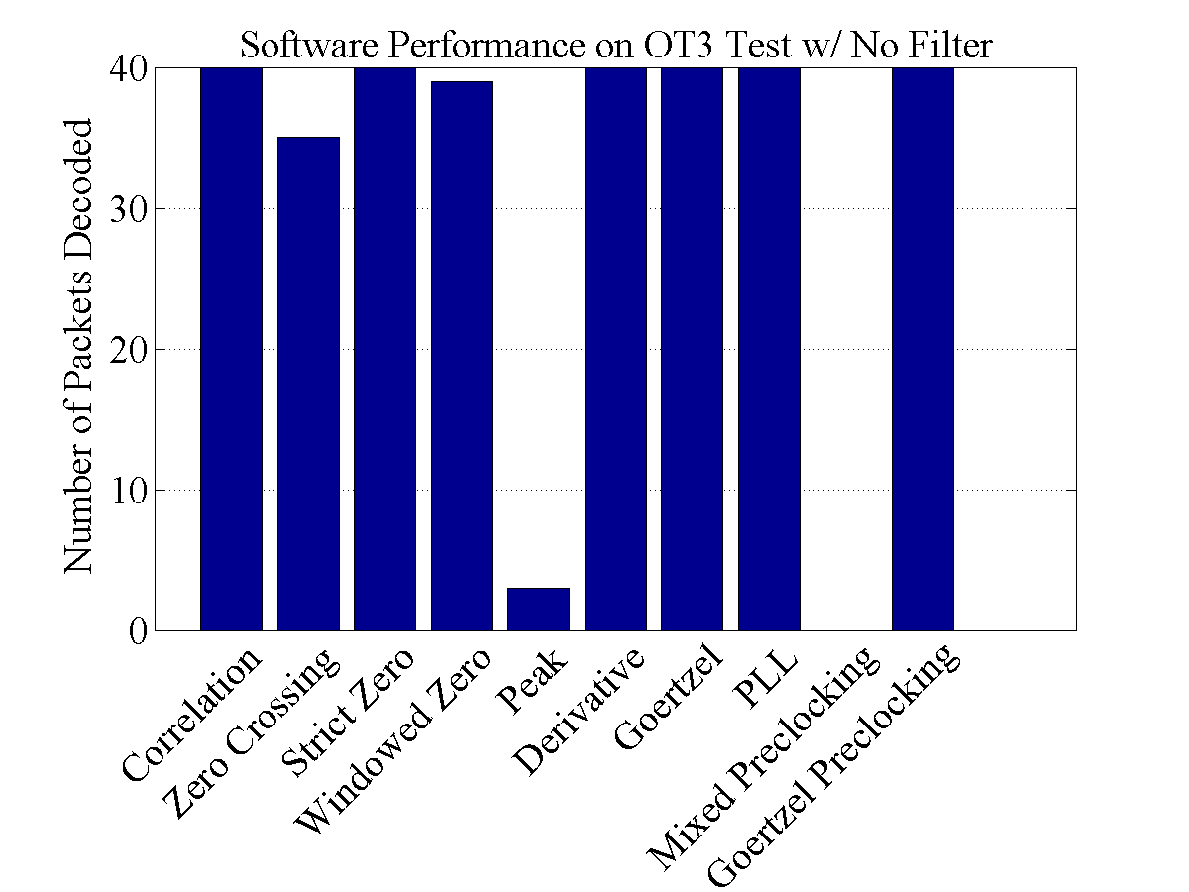
Software Results - Clean

Slide 42
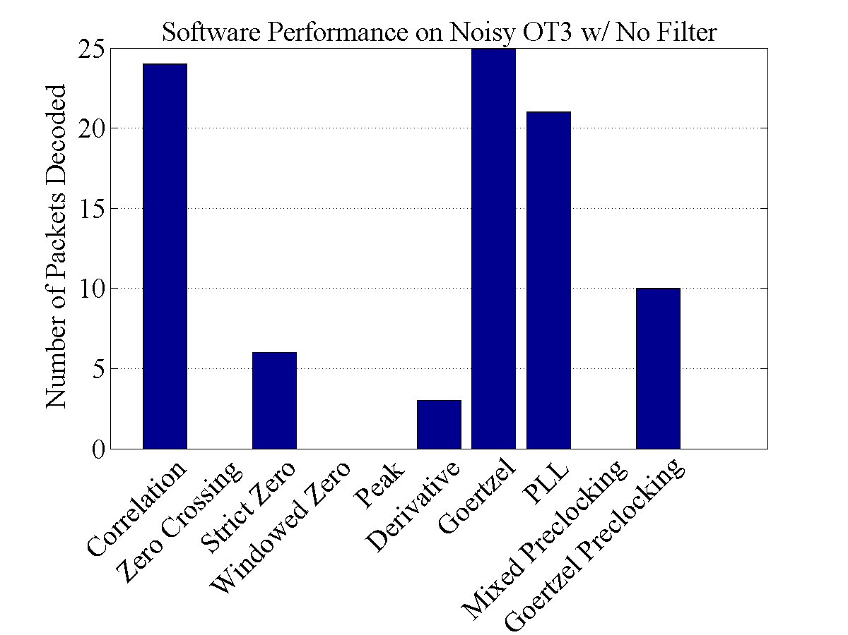
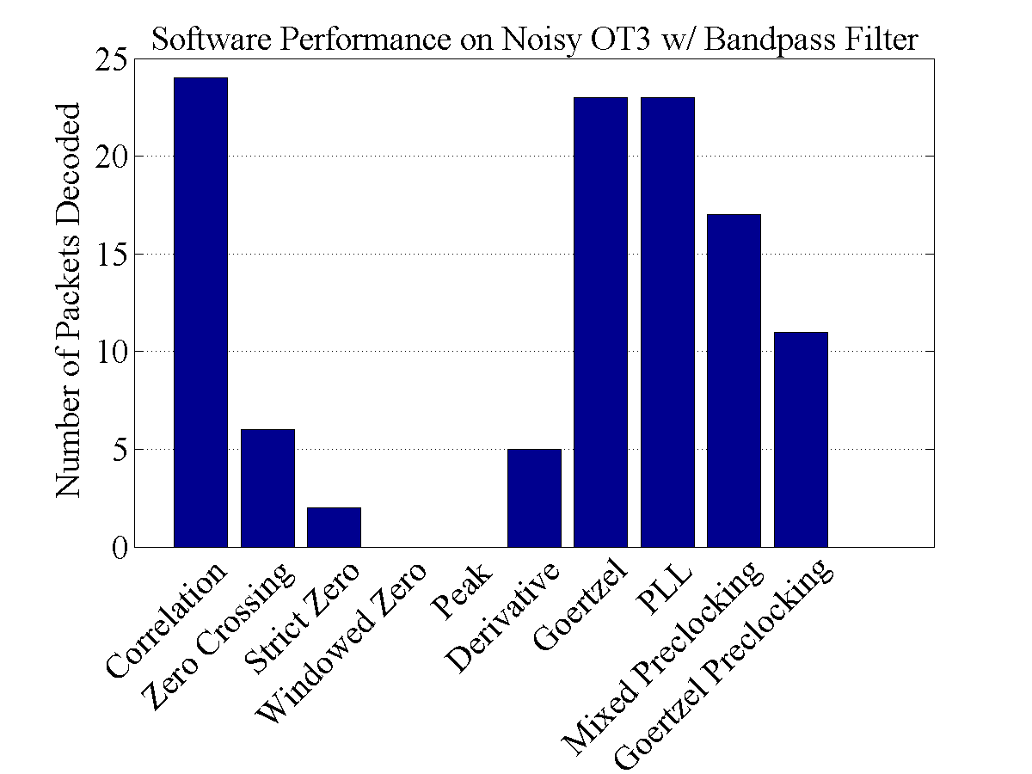
Software Results - Noise

Slide 43
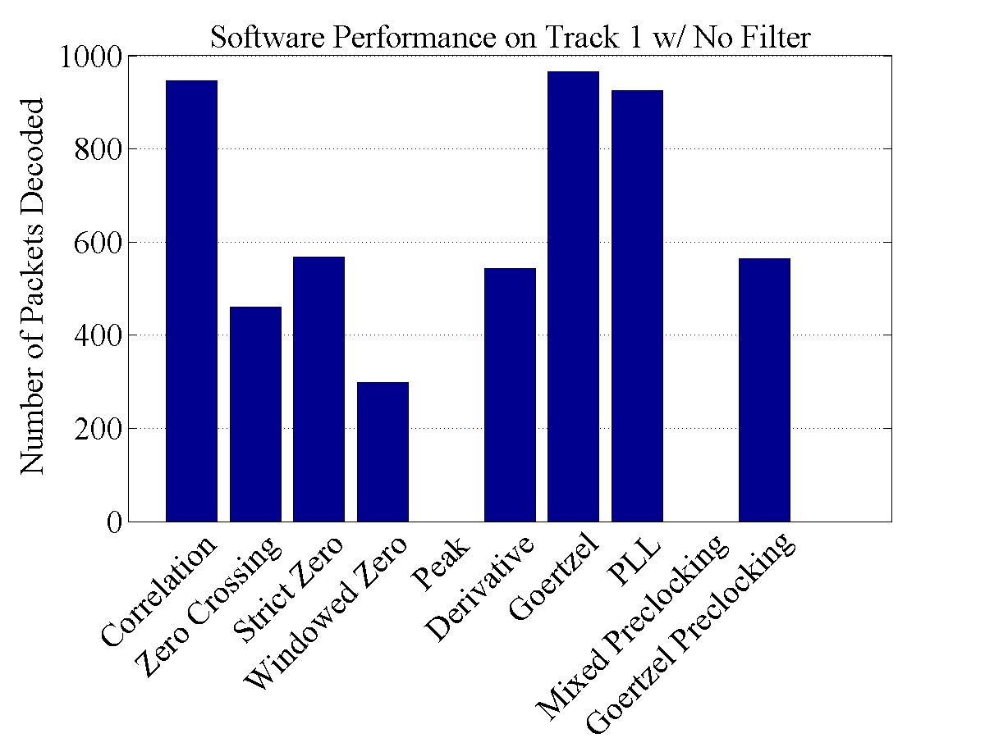
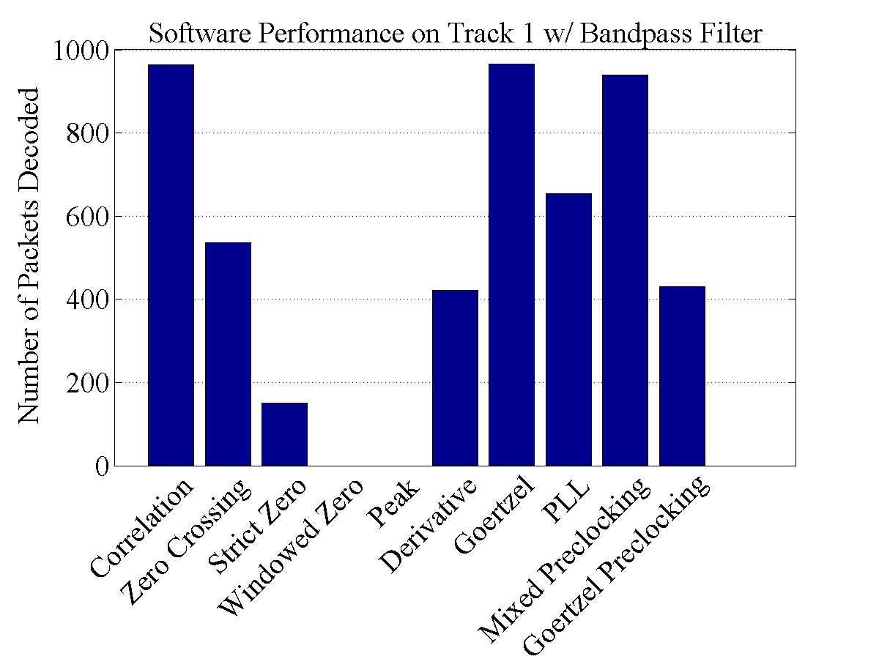
Software Results – Track 1

Slide 44
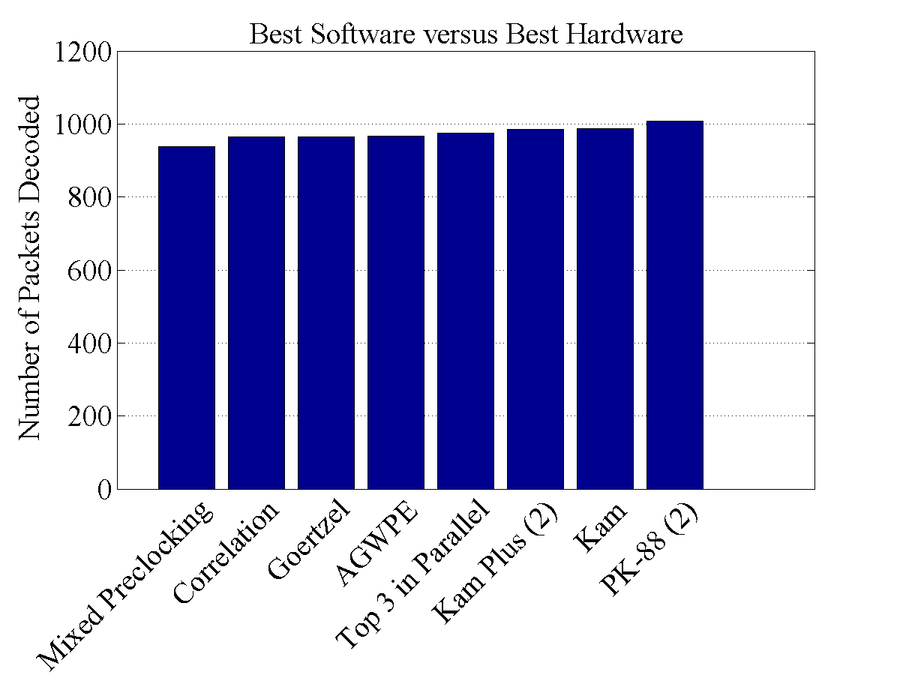
Hardware versus Software
Notes:
All the software is on the left (sad ☹)
Average for hardware was 935, All of these software are above that

Slide 45
Ideas for Future Work
The Discrete Short-Time Fourier Transform
Use the CRC for FEC
Integrations with a Radio
Notes:
Came across paper of DSTFT look like it had good results with fast computation times even in noisy signals

Slide 46
Closing Comments & Questions
Notes:
The software didn’t end up doing as good as hardware (still)
Some quote about just finding some ways that didn’t make it better. Software is limitless and there are many ways left to try.

